Slide 1


BASIC PRINCIPLES OF PROJECT MANAGEMENT
Lecturers : Prof . Nguyễn Văn Hùng
Assoc. Prof. Nguyễn Hải Đăng
Dr. Nguyễn Tường Lan
MSc . Nguyễn Lâm Cường
Assistant Lecturer :
Ms : Đỗ Hoàng Yến
Academic Year : 2025-2026

Slide 2
Lecture 4 :Highlights
1- Lessons learned for Project Management from some very important Implemented Projects in Vietnam

Slide 3
2. North - South500kv high voltage transmission line , circuit 2
Miracle followed by miracle
-After over 10 years of operating the North - South 500kV ultrahigh-voltage transmission line, circuit 1, on 23rd September 2005- 1st July 2008, Vietnam’s Power sector made another new miracle: Completing and putting into operation the North - South 500kV ultrahigh-voltage transmission line, circuit 2, (from 500kV Thuong Tin substation to 500kV Phu Lam substation) with a length of nearly 1,600km. Thus, the North - South 500kV power transmission system has had two parallel circuits to create a strong connection, safe and reliable operation for the national power transmission system.
-The construction of circuit 1 was participated by foreign experts from design consultancy, technical supervision, direct checking and acceptance, etc.,
-The work of circuit 2 was entirely undertaken by Vietnamese officials and engineers, marking the outstanding growth of the staffs and employees of Vietnam’s Power Sector.
-So far, after 25 years of operation, the North - South 500kV power transmission system has made great contributions to the socio-economic development of the country, playing a crucial role in the national power transmission system

Slide 4
2 -Value of Project Management
* The reasons why are projects failed :
Failure to align projects with organizational objectives
Poor scope
Unrealistic expectations
Lack of executive sponsorship
Lack of project management
Inability to move beyond individual and personality conflicts
Politics

Slide 5
* The reasons why projects successfully implemented :
Project sponsorship at executive level
Good project charter
Strong project management
The right mix of team players
Good decision making structure
Good communications
Team members are working toward common goals

Slide 6
3 - The Needs of Project Management
Definition of Project Management :
⃰⃰ PROJECT MANAGEMENT is application of knowledge, skills, tools, and techniques to project activities to achieve project requirements.
⃰ PROJECT MANAGEMENT is accomplished through the application and integration of the project management processes of initiating, planning, executing, monitoring and controlling, and closing.

Slide 7
Project Charter
The project charter typically documents:
- Reasons for the project
- Objectives and constraints of the project
- The main stakeholders
- Risks identified
- Benefits of the project
- General overview of the budget .

Slide 8
The core components of project management are:
defining the reason why a project is necessary
capturing project requirements, specifying quality of the deliverables, estimating resources and timescales
preparing a business case to justify the investment
securing corporate agreement and funding
developing and implementing a management plan for the project
leading and motivating the project delivery team;
managing the risks, issues and changes on the project
monitoring progress against plan
managing the project budget
maintaining communications with stakeholders and the project organization
provider management .
closing the project in a controlled fashion when appropriate.
( in fact , it is the clarification of Project Charter )

Slide 9
Lesson 5 –
Chapter 2
III.The Basic Phases of the Project Management
IV.The Steps of The Project Management
V.The Project Management body of Knowledge
VI. Knowledge Areas Of Project Management

Slide 10
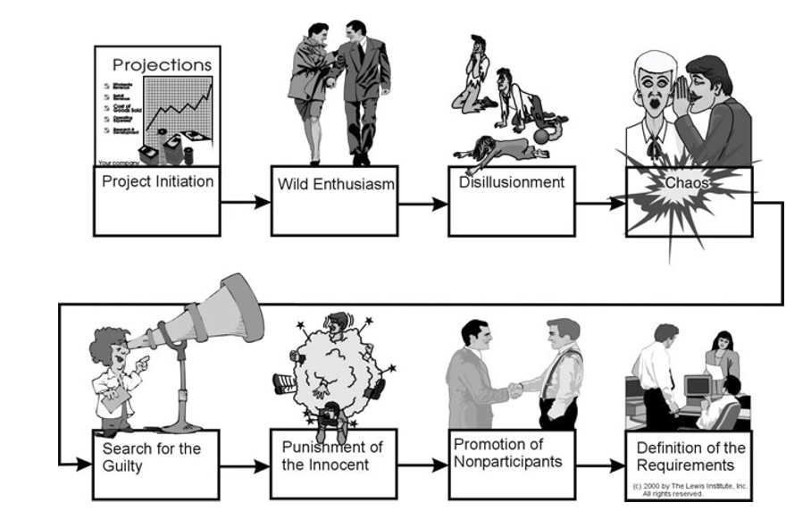
III. The Phases of a Project
Life cycle of a troubled project.
Life cycle of a troubled project.
disillusionment /ˌdɪsɪˈluːʒnmənt/ the state of being disillusioned vỡ mộng

Slide 11
Terminology
Related words
Phase and step
Step :- Step is an advance of one food to other( direct meaning )
Step is subunit of Phase
Phase : Phase is a distinguishable part of a sequence or cycle occurring overtime .
: -giai đoạn , thời kỳ , Pha
distinguishable/dɪˈstɪŋɡwɪʃəbl/distinguishable (from somebody/something) that can be recognized as different from somebody/something else . "có thể phân biệt được" .
Sequence /ˈsiːkwəns/ a set of events, actions, numbers, etc. which have a particular order and which lead to a particular result ; thứ tụ của sự kiện
Terminology /ˌtɜːmɪˈnɒlədʒi/ the set of technical words or expressions used in a particular subject ; thuật ngữ

Slide 12
Terminology
Related words
Stage anf Phase

Slide 13
The difference between stage and Phase
So "stage" and "phase" are very similar
but "stage" has a slightly stronger suggesting of planning,
and of a beginning and end .
whereas "phase" is less clear cut, and may refer to random or
cyclic things.
Stage /ˈsteɪdʒ/. : -giai đoạn hoặc bước đi trong một quá trình, sự phát triển, hoặc một chuỗi sự kiện.
Phase /feɪz/ -giai đoạn , thời kỳ , Pha
Random /ˈræn.dəm/ Ẩu, bừa, ngẫu nhiên

Slide 14
As nouns the difference between phase and process
is that :
- phase is a distinguishable part of a sequence or cycle occurring over time
- process is a series of events to produce a result, especially as contrasted to product.
As verbs the difference between phase and process
is that phase is to begin—if construed with "in"—or to discontinue—if construed with out—(doing) something over a period of time (ie in phases) while process is to perform a particular process or process can be (mostly british) to walk in a procession.

Slide 15
III.Basic Phases
There are 5 basic phases of Project management :
-Project conception and initiation
- Project definition and planning
- Project launch and execution
- Project performance and control
-Project close

Slide 16
III. The Basic Phases of Project Management
  Phase 1 : Project conception and initiation
An idea for a project will be carefully examined to determine whether or not it benefits the organization.
During this phase, a decision making team will identify if the project can realistically be completed or not !?
Phase 1 : qúa trình nhận thức và khởi động dự án .

Slide 17
.Phase 2 : Project definition and planning
-A project plan, project charter or project scope may be put in writing, outlining the work to be performed.
-During this phase, a team should prioritize /praɪˈɒrətaɪz/ the project plan , calculate a budget
and schedule, and determine what resources are needed.
Phase 2 ; Xây dựng điều lệ và kế hoạch thực hiện Dự án ( văn bản ) .

Slide 18
The Basic Phases of Project Management
.Phase 3 : Project launch or execution
-Resources tasks are distributed and teams are informed of responsibilities.
-This is a good time to bring up important project related information.
Phase 3 : Giai đoạn thực hiện các nội dung của Dự án

Slide 19
.Phase 4 : Project performance and control
- Project managers will compare project status and progress to the actual plan, as resources perform the scheduled work.
During this phase, project managers may need to adjust schedules or do what is necessary to keep the project on track.
Phase 4 : Đánh giá và kiểm tra kế hoạch thực hiện

Slide 20
The Basic Phases of Project Management
. Phase 5 : Project close
- After project tasks are completed and the client has approved the outcome, an evaluation is necessary to highlight project success and/or learn from project history.
Projects and project management processes vary from industry to industry; however, these are more traditional elements of a project.
The overarching goal is typically to offer a product, change a process or to solve a problem in order to benefit the organization.
Phase 5 : kết thúc Dự án

Slide 21
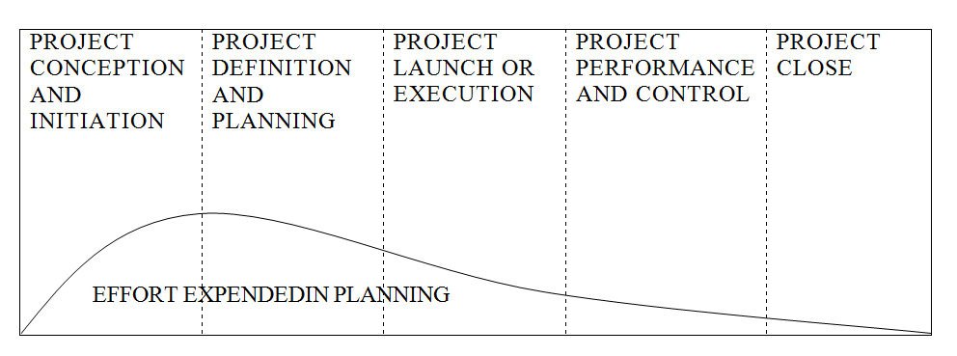
Appropriate project life cycle.

Slide 22
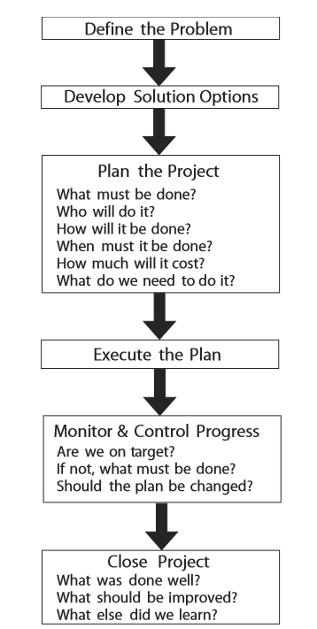
IV. The Steps in Managing a Project

Slide 23
STEPS in Managing a Project
Step 1 : Define the Problem
As was discussed previously, you need to identify the problem to be solved by the project. It helps to visualize the desired end result :
-What will be different?
-What will you see, hear, taste, touch, or smell? (Use sensory evidence if things can’t be quantiﬁed.)
What client need is being satisﬁed by the project?
Visualize /ˈvɪʒuəlaɪz/to form a picture of somebody/something in your mind ; trực quan hóa ,tạo hình ảnh
Sự xác định rõ nhiệm vụ của Dự án

Slide 24
Step 2 : Development of Solution Options
-How many different ways might you go about solving the problem? Brainstorm solution alternatives (you can do this alone or as a group).
- Of the available alternatives, which do you think will best solve the problem? Is it more or less costly than other suitable choices?
-Will it result in a complete or only a partial ﬁx?
brainstorm verb /ˈbreɪnstɔːm/ brainstorm (something) (of a group of people) to all think about something at the same time, often in order to solve a problem or to create good idea ; động não
partial/ˈpɑːʃl/ từng phần , cục bộ
Fix /fɪks/ chỉnh sửa
Triển khai giải pháp lựa chon

Slide 25
Step 3 : Plan the Project
- Planning is answering questions:
what must be done, by whom, for how much, how, when, and so on. Naturally, answering these questions often requires a crystal ball.
- We discuss these steps in more detail in Chapters 2 through 4
Lập kế hoạch Dự án.

Slide 26
Step 4 : Execution of the Plan
Obviously , Once the plan is drafted, it must be
implemented. Interestingly, we sometimes ﬁnd people going to great effort to put together a plan, then failing to follow it.
If a plan is not followed, there is not much point in planning, is there?
- more detailed
Thực hiện kế hoach

Slide 27
Step 5 : Monitor and Control Progress
- Plans are developed so that you can achieve your end result successfully. Unless progress is monitored, you cannot be sure you will succeed. It would be like having a roadmap to a destination but not monitoring the highway signs along the way.
- Of course, if a deviation from the plan is discovered, you must ask what must be done to get back on track, or—if that seems impossible—how the plan should be modified to reflect new realities.
Khảo sát và kiểm tra quá trình thực hiện Dự án

Slide 28
Step 6 : Close the Project
- Once the destination has been reached, the project is ﬁnished, but there is a ﬁnal step that should be taken. Some people call it an audit, others a postmortem (sounds a bit morbid, doesn’t it?). Whatever you call it, the point is to learn something from what you just did. Note the way the
- Questions are phrased: What was done well? What should be improved? What else did we learn? We can always improve on what we have done. However, asking “What did we do wrong?” is likely to make people a bit defensive, so the focus should be on improvement, not on placing blame. More on this later.
Kết thúc Dự án

Slide 29
Questions for Midterm Test
Do please , write down and clarify in details the following questions :
1- why do we have to study project management ?
2- which are the reasons to study project management ?
3- which are the benefits of studying project management ?
4- Which are the Success factors contributions made by the management towards a successful project ?
5 -Which are the typically documents of the Project Charter ?

Slide 30
Refreshment
10 min
Checking attendance

Slide 31
V -THE PROJECT MANAGEMENT BODY OF KNOWLEDGE
The Project Management Institute has attempted to determine a minimum body of knowledge that is needed by a project manager in order for him or her to be effective.
Kiến thức Chuẩn mực về quản lý Dự án

Slide 32
As nouns the difference between phase and process
is that :
- phase is a distinguishable part of a sequence or cycle occurring over time
- process is a series of events to produce a result, especially as contrasted to product.
As verbs the difference between phase and process
is that phase is to begin—if construed with "in"—or to discontinue—if construed with out—(doing) something over a period of time (ie in phases) while process is to perform a particular process or process can be (mostly british) to walk in a procession.

Slide 33
PROJECT PROSSES
Broadly speaking, however, they tend to be employed in the sequence listed as the project progresses.
-That is, initiating is done ﬁrst, then planning, then executing, and so on.
In the event that a project goes off course, replanning comes into play, and if a project is found to be in serious trouble, it may have to go all the way back to the initiating
- process to be restarted.
Các quá trình của Dự án
Progress /ˈprəʊɡres/ the process of improving or developing, or of getting nearer to achieving or completing something

Slide 34
Process of Initiating
Once a decision has been made to do a project, it must be initiated or launched. There are a number of activities associated with this.
- One is for the project sponsor to create a project charter, which deﬁnes what is to be done to meet the requirements of project customers.
-This is a formal process that is often omitted in organizations.
-The charter should be used to authorize work on the project; deﬁne the authority, responsibility, and accountability of the project team; and establish scope boundaries for the job.
- When such a document is not produced, the team members may misinterpret what is required of them, and this can be very costly.
Sự khởi động Dự án
misinterpretˌ/mɪsɪnˈtɜːprət/ to understand something/somebody wrongly

Slide 35
1. Process of Planning
One of the major reason causes of project failures is poor planning.
- Actually , most of the time the problem is caused by there being no planning! The team simply tries to “wing it,” to do the work without doing any planning at all.
As it has explained earlier in this chapter, many of us are task oriented, and we see planning as a waste of time, so we would rather just get on with the work.
As we will see when we turn to controlling the project, failing to develop a plan means that there can be no actual control of the project.
We are just kidding ourselves.
Kế hoạch thực hiện Dự án

Slide 36
2. Process of Executing
There are two aspects to the process of project execution. One is to execute the work that must be done to create the product of the project. This is properly called technical work, and a project is conducted to produce a product.
Note that we are using the word “product” in a very broad sense. A product can be an actual tangible piece of hardware or a building. It can also be software or a service of some kind. It can also be a result—consider, for example a project to service an automobile that consists of changing the oil and rotating the tires.
There is no tangible deliverable for such a project, but there is clearly a result that must be achieved, and if it is not done correctly the car may be damaged as a result.
Quá trình thực hiên Dự án

Slide 37
-Executing also refers to implementing the project plan. It is amazing to ﬁnd that teams often spend time planning a project, then abandon the plan as soon as they encounter some difﬁculty.
- Once they do this, they cannot have control of the work, since without a plan there is no control. The key is to either take corrective action to get back on track with the original plan or to revise the plan to show where the project is at present and continue forward from that point.

Slide 38
3. Process of Monitoring and Controlling
- Monitoring and controlling can actually be thought of as two separate processes, but because they go hand in hand, they are considered one activity.
-Control is exercised by comparing where project work is to where it is supposed to be, then taking action to correct for any deviations from target.
Now the plan tells where the work should be. Without a plan, you don’t know where you should be, so control is impossible, by definition
Monitor /ˈmɒnɪtə(r)/to watch and check something over a period of time in order to see how it develops, so that you can make any necessary change
control/kənˈtrəʊl/ the power to make decisions about how a country, an area, an organization, etc. is run
Qúa trình khảo sát và kiểm tra
deviation/ˌdiːviˈeɪʃn/ a difference from what is expected or acceptable

Slide 39
-Furthermore, knowing where you are , is done by monitoring progress. An assessment of quantity and quality of work is made using whatever tools are available for the kind of work being done.
The result of this assessment is compared to the planned level of work; if the actual level is ahead or behind of the plan, something will be done to bring progress back in line with the plan.
Naturally, small deviations are always present and are ignored unless they exceed some pre-established threshold or show a trend toward drifting further off course.
Threshold /ˈθreʃhəʊld/the floor or ground at the bottom of a doorway, considered as the entrance to a building or room
Drift to move slowly, especially as a result of outside forces, with no control over direction .

Slide 40
4. Process of Closing
In too many cases, once the product is produced to the customer’s satisfaction, the project is considered ﬁnished, or closed.
-This should not be the case : a ﬁnal lessons-learned review should be done before the project is considered complete.
- Failing to do a lessons-learned review means that future projects will likely suffer the same headaches encountered on the one just done.
Quá trình kết thúc dự án

Slide 41
VI - Knowledge Areas
As previously mentioned, the PMBOK® Guide identiﬁes nine knowledge areas that project managers should be familiar with in order to be considered professionals. These are as follows:
Lĩnh vực kiến thức về quản lý dự án

Slide 42
1- Project Integration Management
Project integration management ensures that the project is properly planned, executed, and controlled, including the exercise of formal project change control. As the term implies, every activity must be coordinated or integrated with every other one in order to achieve the desired project outcomes.
Quản lý tich hợp Dự án ( Lĩnh vực )

Slide 43
2- Project Scope Management
- Changes to project scope are often the factors that kill a project. Project scope management includes authorizing the job, developing a scope statement that will deﬁne the boundaries of the project, subdividing the work into manageable components with deliverables, verifying that the amount of work planned has been achieved, and specifying scope change control procedures. Project Time Management, is considered as a bad choice of terms, as “time management” implies personal efforts to manage one’s time. Project time management speciﬁcally refers to developing a schedule that can be met, then controlling work to ensure that this happens! It’s that simple. Because everyone refers to this as scheduling, it should really be called schedule management. (I know, I may be booted out of PMI for such heresy!)
Quản lý Phạm vi của Dự án

Slide 44
3- Project Cost Management
This is exactly what it sounds like. Project cost management involves estimating the cost of resources, including people, equipment, materials, and such things as travel and other support details. After this is done, costs are budgeted and tracked to keep the project within that budget.
Quản lý Chi phí Dự án

Slide 45
4- Project Quality Management
As it hase been commented earlier, one cause of project failure is that quality is overlooked or sacriﬁced so that a tight deadline can be met. It is not very helpful to complete a project on time, only to discover that the thing delivered won’t work properly! Project quality management includes both quality assurance (planning to meet quality requirements) and quality control (steps taken to monitor results to see if they conform to requirements).
Quản Lý Chất lượng Dự án

Slide 46
5- Project Human Resources Management
Project human resources management, often overlooked in projects, involves identifying the people needed to do the job; deﬁning their roles, responsibilities, and reporting relationships; acquiring those people; and then managing them as the project is executed. Note that this topic does not refer to the actual day-to-day managing of people. The PMBOK® Guide mentions that these skills are necessary but does not attempt to document them. Given that these are the most important skills that a project manager must have, the PMBOK® Guide is deﬁcient in omitting them.
Quản lý nguồn nhân lực Dự án

Slide 47
6- Project Communications Management
As the title implies, project communications management involves planning, executing, and controlling the acquisition and dissemination of all information relevant to the needs of all project stakeholders. This information might include project status, accomplishments, and events that may affect other stakeholders or projects. Again, this topic does not deal with the actual process of communicating with someone. This topic is also mentioned but not included in the PMBOK® Guide.
- Plan communication Management
- Manage communication
- Control Communication

Slide 48
7- Project Risk Management
Project risk management is the systematic process of identifying, quantifying, analyzing, and responding to project risk. It includes maximizing the probability and consequences of positive events and minimizing the probability and consequences of adverse events to project objectives. This is an extremely important aspect of project management that sometimes is overlooked by novice project managers.
Quản lý rủi ro của dự án

Slide 49
8- Project Procurement Management
Procurement of necessary goods and services for the project is the logistics aspect of managing a job. Project procurement management involves deciding what must be procured, issuing requests for bids or quotations, selecting vendors, administering contracts, and closing them when the job is ﬁnished.
- Contract or agreement ,Understanding,subcontract ,purchase order
- Documenting how to manage procurement in a project :Project procurement decision ,specifying approach….
- Conduct procurements : obtaining sellers …..
- Control procurement : managing procurement relationships ,correction contracts …….
- Close procurements : completing each procurement
Procurement / prǝ′kjuǝmǝnt / Quản lý thu mua của Dự án

Slide 50
9- Success Factors
Success factors are contributions made by the management towards a successful project. These can be classified broadly into five groups as follows:
The project manager - The person needs to have an array of skills under his arm to use during the project.
Project team - The team needs to consist of variety of skills and experience. Collectively as a team, success is easy to achieve with proper guidance.
Project - The scope and timeline of the project is crucial.
Organization - The organization needs to provide support to both the project manager and the project team.
External environment - External constraints should not affect the project. Back-up plans need to be in place in case daily tasks cannot be carried by the team.
Factor /ˈfæktə(r)/ nhân tố , yếu tố

Slide 51
Further Project Success Criteria
The criteria for a successful project are not restricted to only above. However, following are some of other supporting factors that need to be considered when it comes to a successful project management and execution:
Negotiations
Proper and conducive project plan
Assigning tasks to the team members
Developing a plan to achieve common tasks
Reviewing and doing a rework when needed
Managing project risks efficiently
Allocating time for process improvement
Learn from the learning curve
Proper estimation of project in terms of not only quantitatively but also qualitatively
Criteria /kraɪˈtɪəriə/ tiêu chuẩn đấnh giá

Slide 52
Indicators to ensure the success of a project
Completing the amounts of tasks/work shown by quantitative criteria for evaluation
Meeting the deadline
Within the budget
Indicator /ˈɪndɪkeɪtə(r)/ chỉ báo

Slide 53
Law of project management
Projects progress quickly until they become 90% complete, then they remain at 90% complete forever.
When things are going well, something will go wrong.
When things just cannot get any worse, they will.
When things appear to be going better, you have overlooked something.
No major project is ever installed on time, within budget, or with the same staff that started it. Yours project will not be the first.
No system is ever completely debugged. Attempts to debug a system inevitably introduce new bugs that are even harder to find.
A carelessly planned project will take 3 times longer to complete than expected.
A carefully planned project will take only twice as long.
Project teams detest progress reporting because it vividly manifests their lack of progress.
Debug/ˈdiːbʌɡ/ the process of looking for and removing faults in a computer program ; Gỡ lỗi
Detest /dɪˈtest/ to hate somebody/something very much ; gét cay gét đắng
Manifest/ˈmænɪfest/manifest something to show something clearly, especially a feeling, an attitude or a quality ; bằng chứng

Slide 54
Law
The meanings of the word : LAW
1- Law : judicial /dʒuˈdɪʃl/connected with a court, a judge or legal judgement ; Luật pháp
-a rule that deals with a particular crime, agreement, etc .
2- Law : Qui luật
-Law of life : quy luật của cuộc sống
3-Law in sciences : định luật
Law in Physics : Newton’S Law Of Universal Gravitation

Slide 55
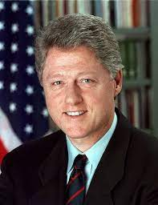
US President
1992-2000

Slide 56
Remarks of US President B. Clinton at a State Dinner , hosted by President Tran Duc Luong on Nov/11/2000 .
…In short, people will look back and reach the same conclusion as the great Vietnamese statesman Nguyen Trai when he said 500 years ago,
"After so many years of war, only life remains.“
As "The Tale of Kieu" foretold, :
"Just as the lotus wilts, the mums bloom forth;
time softens grief; and the winter turns to spring."
" Sen tàn cúc lai nở hoa
Sàu dài ngày ngắn Đông đà sang Xuân "
Now the frozen/ˈfrəʊzn/ images of the past have begun to thaw/θɔː/. The outlines of a warmer shared future have begun to take shape. Let us make the most of this new spring together.
Quote /kwəʊt/ repeat exact wordsto repeat the exact words that another person has said or written ; trich dẫn In the case : lẩy kiều

Slide 57
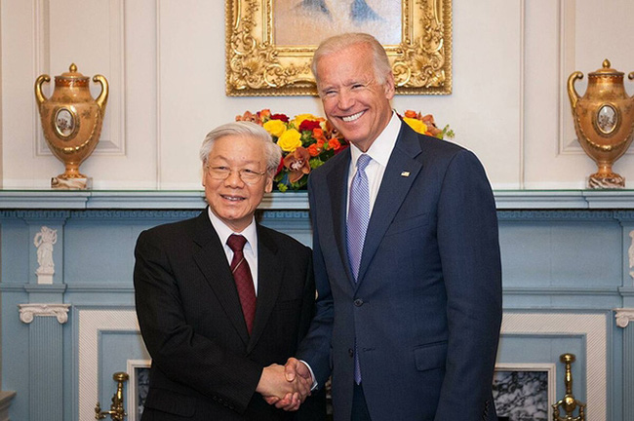
Law of LIFE
Vice President J. Biden of US: received our Secretary General
Prof.Nguyễn Phú Trọng in the White House ,2015
"Thank heaven we are here today/To see the sun through parting fog and clouds"
" Trời còn để có hôm nay
Tan sương đầu ngõ , vén mây giữa Trời "

Slide 58
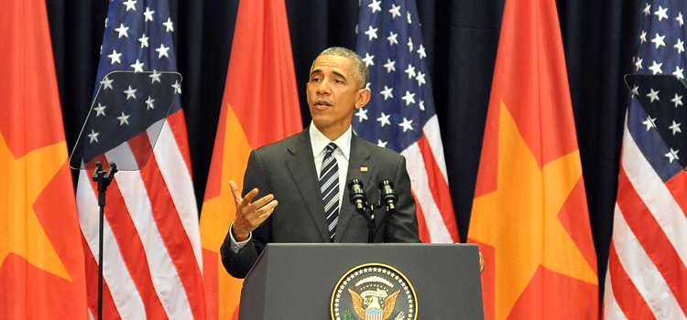
Law 0f LIFE
- President of US: Barack Obama visited VN 2016
“Please take from me this token of trust,
so we can embark upon our 100-year journey together.”
“ Rằng trăm năm cũng từ đây
Của tin còn một chút này làm ghi ..”

Slide 59
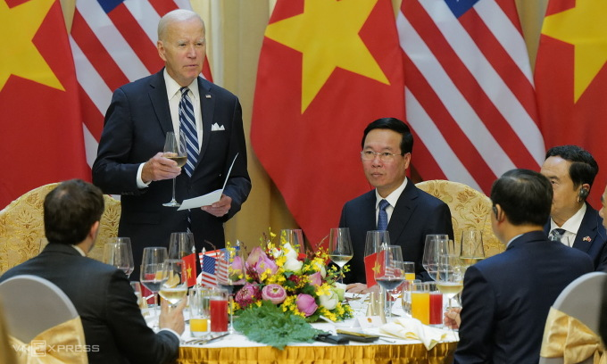
U.S. President Joe Biden cited lines from "The Tale of Kieu" to highlight the elevated Vietnam and U.S. relationships at a banquet hosted by Vietnamese President Vo Van Thuong Monday."Mr. President, the great Vietnamese poet Nguyen Du once wrote, 'In glory they made up for their past hardships, and their love got fresher and warmer each day',"U.S. President Joe Biden cited lines from "The Tale of Kieu" to highlight the elevated Vietnam and U.S. relationships at a banquet hosted by Vietnamese President Vo Van Thuong Monday

Slide 60
“In glory they made up for their past hardships, and their love got fresher and warmer each day “
“ Vinh hoa bõ lúc phong trần
Chữ tình ngày laỊ thêm xuân một ngày “

Slide 61
Key Points to Remember
A project is a temporary endeavor undertaken to produce a unique product, service, or result.
A project is also a problem scheduled for solution.
Project management is application of knowledge, skills, tools, and techniques to project activities to meet project requirements. Project management is accomplished by applying the processes of initiating, planning, executing, monitoring and controlling, and closing.
All projects are constrained by Performance, Time, Cost, and Scope requirements. Only three of these can have values assigned. The fourth must be determined by the project team.
Projects tend to fail because the team does not take time to ensure that they have developed a proper definition of the problem being solved.
The major phases of a project include concept, definition, planning, execution and control, and closeout.

Slide 62
Questions for Midterm Test
Do please , write down and clarify in details the following questions :
1- why do we have to study project management ?
2- which are the reasons to study project management ?
3- which are the benefits of studying project management ?
4- Which are the Success factors contributions made by the management towards a successful project ?
5 -Which are the typically documents of the Project Charter ?

